Slide 1
user need
capability
capability
capability
capability

Slide 2
user need
capability
capability
capability

Slide 3
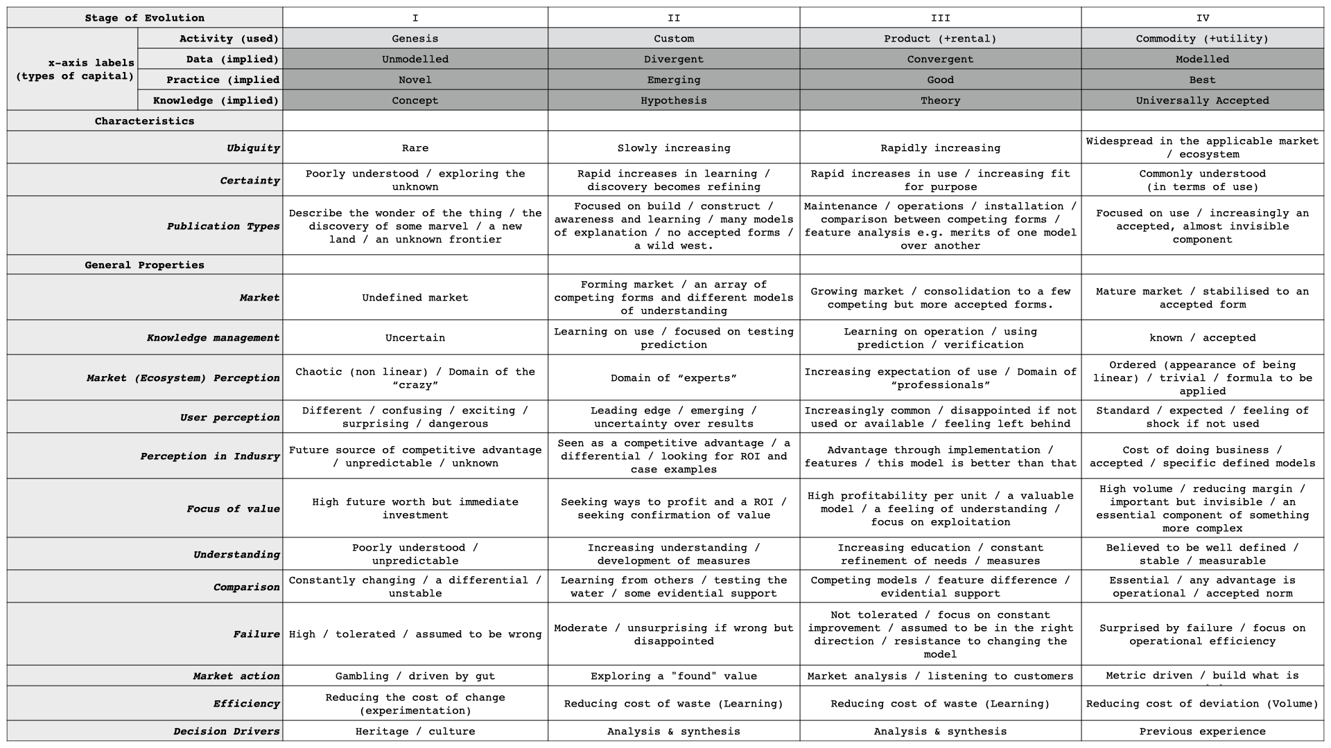
Characteristics change as things evolve.
Stage 1 | Stage 2 | Stage 3 | Stage 4
We don’t get it at all. | We’re learning a lot about it. | Now we’re using it, more and more. | We totally get it. It’s useful for...
Look at this thing! It’s really cool! | Here’s what it is, how it works, and how to make one. | Let’s talk about features, installation, operations, and maintenance. | It’s a basic component we use to enable...
Speculative future worth. | Could have ROI? | How can we maximize profit? | How can we run it at scale, with our tight profit margins?
This thing hardly works. | Failure is disappointing, but not surprising. | Failure is unacceptable. Make it better! | Failure is super rare and surprising.
Its market is unknown. | Its market is forming. | Its market is growing. | Its market is mature.
Based on the work of Simon Wardley, CC BY-SA 4.0, creativecommons.org/licenses/by-sa/4.0
Notes:
Courtesy of Simon Wardley, CC BY-SA 4.0 https://creativecommons.org/licenses/by-sa/4.0/

Slide 4
Users
needs
Example
capabilities
stay awake
potential capabilities
point of interest
addressing the symptom, not the problem?
alternative
caffeination
rest
cup of coffee?
sleep schedule
cup of tea
hot water
tea
cup
why is this custom?
kettle
water
power

Slide 5
Template Courtesy of:
Ben Mosior (@hiredthought)
Sue Borchardt (@contemplatethis)
Licensed Creative Commons Attribution Share-Alike 4.0
https://creativecommons.org/licenses/by-sa/4.0/
Visit LearnWardleyMapping.com for more information.

